Slide 1
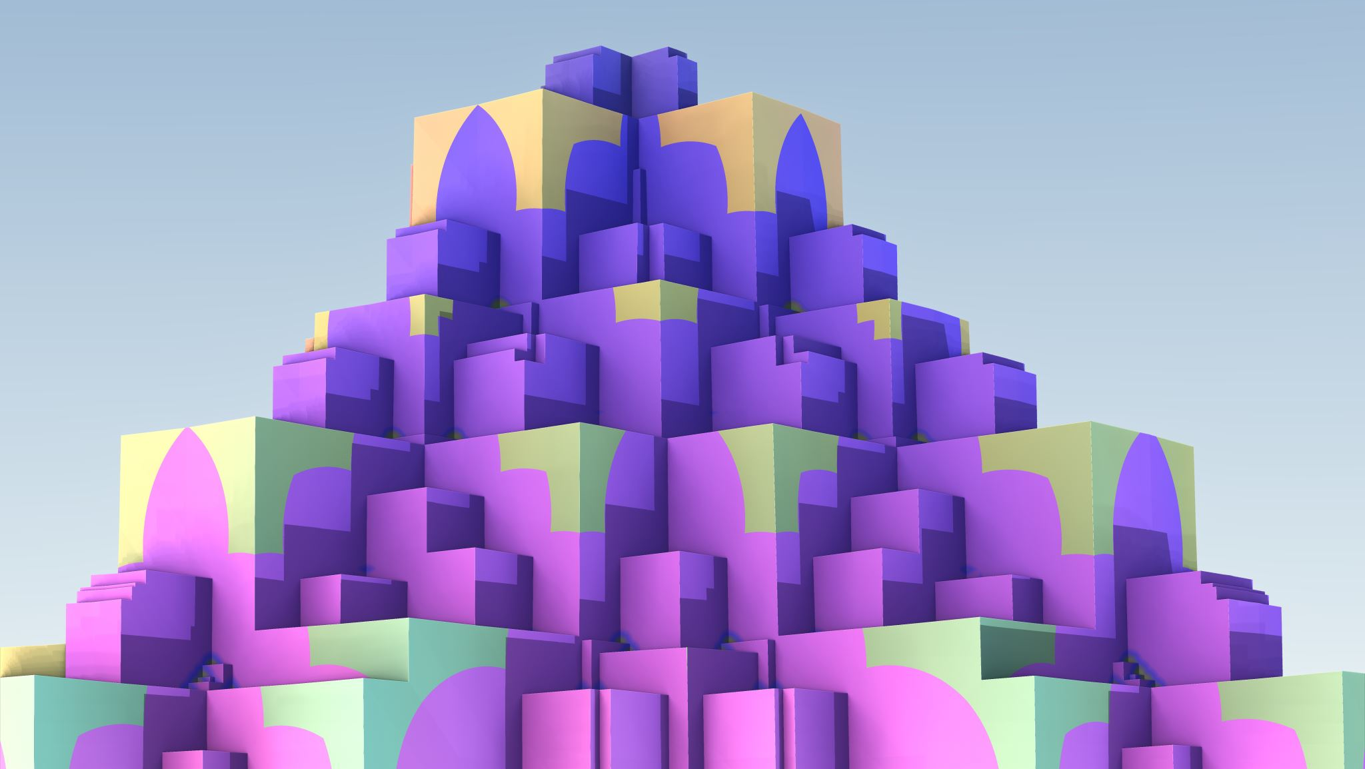
Praxis Approach
Design

Slide 2
LLM Approach
Document
Window
Window
Document
LLM
LLM
LLM can process the entire document for documents that are smaller than its window
LLM can only process a subset of the document or documents that extend beyond its window

Slide 3
Attention and Focus
Vehicles
Vehicles
Weather
Weather
Animals
Animals
Attention looks at everything. It identifies how similar a cat is to a car.
Focus looks at a subset and only pays attention to that subset. Is this cat in front of me dangerous?

Slide 4
Proposed Approach
Document
Partition Document into Chunks
Chunks
LLM / Prompt
Knowledge Graphs
LLM / Prompt
Grouped Knowledge Graphs
Process a document or documents into chunks. This will require multiple passes to ensure chunk boundaries are fully addressed.
Process Chunks into one Knowledge Graph per Entity
Identify type of each entity and group together

Slide 5
Proposed Architecture
D – Data
KG – Knowledge Graph
P – Processing
(KG2)
Long-Term Memory
(P5)
Long Term Memory Processing
(D1)
Documents
Out of scope
(P1) Document Processing
(P4)
Long Term Memory Formation
(D3)
Responses
Out of scope
(P6)
Response Processing
Agent
(D2)
Queries
(P3)
Input Processing
(KG1)
Short-Term Memory
(P2)
Query Processing

Slide 6
Proposed Architecture
Short Term Memory
Long Term Memory
Entity 1
Entity 2
Entity 3
Entity 1
Entity 2
Type List
Entity 3

Slide 7
Notes
What is the validation?
Introduce errors to measure how well it does
Introducing errors into documents.
Start with smaller documents.
Partition the document.
Errors within a partition
Errors between partitions
Metrics
Number of chapters
Number of words
How many pages are processed
How long does it take?
How well does it scale?
Top non noise words
To do
Continue Research – focus is on Knowledge Graphs
Continue Methodology
Update chapter 1

Slide 8
Implementation Notes
Date | Item | Notes
3/10/2025 | Normalizing Names of things | Names of entities, properties, and relationships seem to be getting generated haphazardly. For example, we have properties named AdoptionDate, adoptiondate, Adoption_Date, and adoption_date. I tried to have the LLM normalize these. But the results were not that great and it applied the same normalization to descriptions. So, rather than fight it, I can programmatically normalize them in STM before consolidating into LTM. There will still be outliers. I am not sure I could normalize every instance of Adoption_Date and adoptiondate.
3/7/2025 | Tracking the source | To tell the user where a problem comes from, I need to track each entity back to one or more sources. I have tried some approaches and currently have the document as one entity and the chunk as another. This is not very useful since chunks are ill defined and can change size. A better approach might be the starting and ending paragraph numbers. It should narrow it down and the document class can recreate them.

Slide 9
Implementation Notes
Date | Item | Notes
3/10/2025 | Chunk Names | Since chunks point to a document, the chunk name needs t include the document and chunk. This way if two documents are processed, their chunks will not be intermingled. Even if I switch to Paragraph Numbers, this will still be true – Document Name and Paragraph Number as the name. I will add a property for the Name, so that it is easy to get just the name.
3/10/2025 | Entity Names | Entities are of a type. So, the entity name needs to include both the Type and the Entity Name. This will allow be to have two entities with the same name but a different type. I will add a property for the Name, so it is easy to get just the name. Example: In Type-EntityName Company-Apple, Fruit-Apple.

Slide 10
Implementation Notes
Date | Item | Notes
3/10/2025 | Long Term Memory Consolidation | Long term memory will be very large. It will need to be consolidated in stages. I think it is also best to select areas at random for consolidation. There are multiple types of consolidating: Type hierarchy. Look at types and see if a super type can be created. Consolidation of types. Look at the type hierarchy and see if any are redundant and need to be joined or need to be split. During the join include all the entities and rename them. For a split, the entities must also be split and renamed. Change entity type. Review entity properties and merge entities under one type if they all have the same properties.
3/10/2025 | Usage / Frequency | Things that appear more often are more important. So, we need to track how often something is seen. I am not sure what that would drive.

Slide 11
Implementation Notes
Date | Item | Notes
3/10/2025 | Focus | When responding to a prompt focus on things of the right type.
3/10/2025 | Properties vs Relationships | An entity can have a property called Color with the value Blue. Or it could have a relationship with the name Color to the entity that is the Color Blue. My preference is relationships over properties. Proper

Slide 12
Implementation Notes
Date | Item | Notes
3/22/2025 | Moved Methods | In the Mind Class I grouped all the LLM and Neo4j together. This will help with updates to the Json Schema.
3/23/2025 | STM Types | I plan to support Declarative and Interrogative types in STM. The Declarative items will be consolidated into LTM. The Interrogative Types will be used for generating responses. This is a future but I put it in place now, so everything is ready.

Slide 13
Future Research
Date | Item | Notes

Slide 14
Neo4j Nodes
Item | Label | Properties | Notes
Node | Entity | name: originalName: created: used: | Cannot be combined with EntityType or Source labels. Set created to the current UTC date and time when the node is created. In the future, used may be incremented by one each time this node is referenced.
 | EntityType and {Type} | created: level: leaf: {type specific properties} | Cannot be combined with Entity or Source labels. {Type} is a label that is the name of the type. Such as Person, Car, etc. There can be one node with the labels EntityType and Unknown, this node will be used for Entity nodes with a type that is not known For EntityType Nodes, the name is a Label, not a property. Set created to the current UTC date and time when the node is created. Level is the distance from the root, starting at zero for the root. The value of leaf is true if it is a leaf node and false otherwise.
 | Source | name: created: | Cannot be combined with Entity, EntityType, or {Type} labels. Something that can be the source of Nodes with the label of Entity. Set created to the current UTC date and time when the node is created.
 | DoNotChange |  | Can be combined with Entity, EntityType, or Source labels. The rearrangement processes will not change this node.

Slide 15
Neo4j Relationships
Item | Label | Properties | Notes
Relationship | IS_A | created: | Used to represent the type hierarchy. Set created to the current UTC date and time when the node is created.
 | PART_OF | created: | Used to represent the parts of a whole. Set created to the current UTC date and time when the node is created.
 | FROM | chunk: fromParagraph: toParagraph: seen: created: | The FROM relationship must have a Node with the label Entity on one end and a Node with the label Source on the other end. The value of seen is the number of times this Entity has been seen in this Source. Set created to the current UTC date and time when the node is created.
 | {any other} | {relationship specific properties} originalName: created: | The label is normalized The originalName is the name before normalization Set created to the current UTC date and time when the node is created.

Slide 16
Data Definitions
ID | Item | Use | Notes
D1 | Documents | Word documents stored and ready for use.
D2 | Queries | These are questions about the documents that have been processed into long term memory.
D3 | Response

Slide 17
Knowledge Graph Definitions
ID | Item | Use | Notes
KG1 | Short-Term Memory | Consolidation of knowledge graphs from all input processing. | I am not sure if it is one graph, one graph per input, or one graph per type. I am not sure how to store it. How do I relate back to the document?
KG2 | Long-Term Memory | Consolidation of knowledge graphs from all processing. | I am not sure if it is one graph, one graph per input, or one graph per type. I am not sure how to store it.

Slide 18
Processing Definitions
ID | Item | Use | Notes
P1 | Document Processing | Process a document into chunks that can be processed by the Input Processing. | Each run add one or more knowledge graphs into the short-term memory. A first cut of the type is assigned. It needs to store the source with the knowledge graph.
P2 | Query Processing | Prepare the query for Input Processing.
P3 | Input Processing | Using a prompt like: Process this input into a knowledge graph and assign attributes to each entity. There should be a type hierarchy. A first cut of the type should be assigned. | A future direction would be to have an LLM that specifically knows how to do this task.

Slide 19
Processing Definitions
ID | Item | Use | Notes
P4 | Long Term Memory Formation | A prompt like: Review the knowledge graph in the short-term memory and integrate it into the long-term memory resolving any duplicates and consolidating into a consistent type hierarchy. | The knowledge graphs in the short-term memory are consolidated into the long-term memory. They are then removed from short term memory. This is run periodically. Could be when input is quiet for a period or every hour.
P5 | Long Term Memory Processing | A prompt like: Review all nodes of the knowledge graphs and look for ways to improve them by creating new relationships, adding attributes, making similar things similar. Replace with the better version. | Runs once a day to keep the long-term memory well organized.

Slide 20
Processing Definitions
ID | Item | Use | Notes
P6 | Response Processing Agent | An agent that reviews the short-term memory looking for things that it can respond to. Uses a prompt like: Review the short-term memory and look for items that you can respond to. Use the long-term memory if needed.

Slide 21
Processing Steps
Load
Load up one or more documents
Start
Start the document processing (How?)
Wait
Give it time for background processes to work
Query
Issue prompts to ask questions

Slide 22
Notes
Which LLM should I use?
What structure should the knowledge graph be? I am thinking XML.
How can I make the knowledge graph more like a Frame with Slots?
Should the knowledge graph be stored in OS files or a structured storage mechanism?
I would like to store everything in a Neural Network. Could be a future direction.

Slide 23
Future Directions
Create task specific LLMs
Store Knowledge Graphs in Neural Networks
Make Knowledge Graphs into Frames

